Slide 1

What are some High Value Use Cases of Knowledge Graphs?

Slide 2
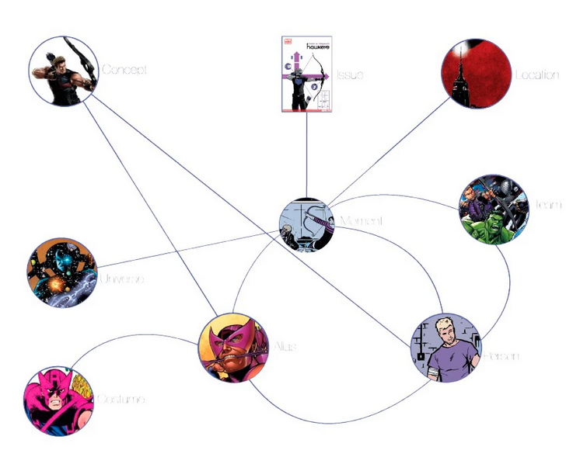
Applications of Knowledge Graphs
Entertainment: Knowledge Graph of Marvel’s Cinematic Universe

Slide 3

Applications of Knowledge Graphs
Investigative Journalism

Slide 4
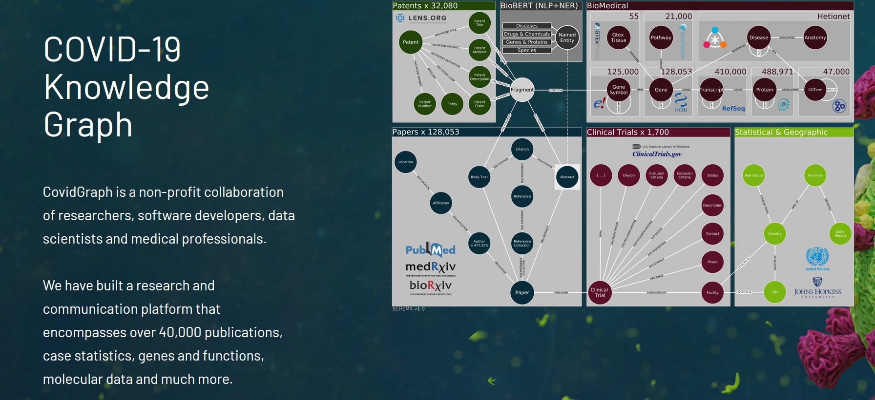
Applications of Knowledge Graphs
Biomedicine

Slide 5
Outline
Knowledge Graphs in Finance
Financial Analytics
Financial Calculations
Financial Reporting

Slide 6
Knowledge Graphs for Financial Analytics
Example business questions
Which of our clients are suppliers of company X that is in financial trouble?
In a supply chain network, is there a single company that connects a group of companies?
Which startups have attracted most influential investors?
Which group of investors tend to coinvest?
Which companies are most similar to a given company?
Which company might be a good future client for us?

Slide 7

Knowledge Graphs for Financial Analytics
Which of our clients are suppliers of company X that is in financial trouble?
Who supplies to who?
Who are my customers?
INTERNAL
COMPANY
DATA

Slide 8
Knowledge Graphs for Financial Analytics
Which of our clients are suppliers of company X that is in financial trouble?
Answered using path finding
Who supplies to who?
Who are my customers?
INTERNAL
COMPANY
DATA
B
A
C
D
E

Slide 9
Knowledge Graphs for Financial Analytics
In a supply chain network, is there a single company that connects a group of companies?
Who supplies to who?
Who are my customers?
INTERNAL
COMPANY
DATA

Slide 10
Knowledge Graphs for Financial Analytics
In a supply chain network, is there a single company that connects a group of companies?
Answered using between-ness centrality
Who supplies to who?
Who are my customers?
A
INTERNAL
COMPANY
DATA
B

Slide 11

Knowledge Graphs for Financial Analytics
Which startups have attracted most influential investors?
Who are my customers?
Who is funding who?
INTERNAL
COMPANY
DATA

Slide 12
Knowledge Graphs for Financial Analytics
Which startups have attracted most influential investors?
Answered using page rank
Who are my customers?
Who is funding who?
INTERNAL
COMPANY
DATA

Slide 13
Knowledge Graphs for Financial Analytics
Which group of investors tend to coinvest?
Who are my customers?
Who is funding who?
INTERNAL
COMPANY
DATA

Slide 14
Knowledge Graphs for Financial Analytics
Which group of investors tend to coinvest?
Answered using community detection algorithms
Who are my customers?
Who is funding who?
A
INTERNAL
COMPANY
DATA
B

Slide 15
Knowledge Graphs for Financial Analytics
Example business questions
Which companies are most like a given company?
Use graph embeddings to calculate similarity
Which company might be a good future client for us?
Use link prediction to identify future customers

Slide 16
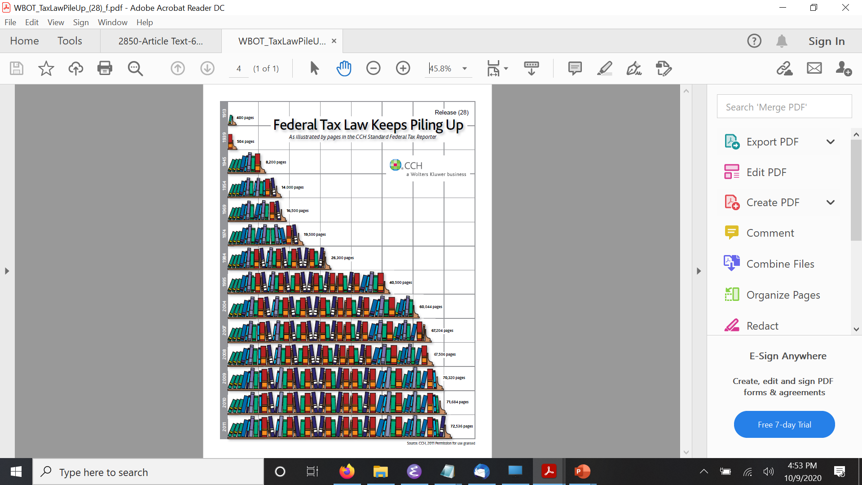
Knowledge Graphs for Financial Calculations
Federal Tax Law
72,000 pages
1000s forms
Changing every year

Slide 17
Knowledge Graphs for Financial Calculations
Model the tax law using a set of rules
Leverage the graph structure in the rules to
Generate user interviews/dialogs
Apply the rules for tax calculations

Slide 18
Knowledge Graphs for Financial Calculations
A person is qualified for a tax benefit if:
the person is a resident of California, and
the age of the person is greater than 18 years

Slide 19
Knowledge Graphs for Financial Calculations
A person is qualified for a tax benefit if:
the person is a resident of California, and
the age of the person is greater than 18 years
qualified_for_tax_benefit(P) :- resident_of(P,CA) & age(P,N) & min(N,18,18)

Slide 20
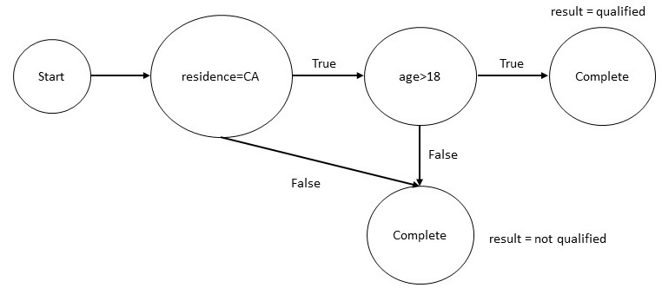
Knowledge Graphs for Financial Calculations
A person is qualified for a tax benefit if:
the person is a resident of California, and
the age of the person is greater than 18 years
qualified_for_tax_benefit(P) :- resident_of(P,CA) & age(P,N) & min(N,18,18)

Slide 21
Knowledge Graphs for Financial Calculations
Intuit has developed a tax knowledge engine to capture tax law
The graph structure of the rules drives TurboTax® line of products

Slide 22
Knowledge Graphs for Financial Reporting
Financial Reporting Requirements
Derivative contracts
Interest rate and commodity swaps
Options
Futures
Forwards
Asset back securities

Slide 23
Knowledge Graphs for Financial Reporting
Financial Reporting Requirements
Consumer of the reports
Internal compliance teams
Brokers and dealers
Regulators

Slide 24
Knowledge Graphs for Financial Reporting
Financial Reporting Requirements
Standardize the reports using FIBO
FIBO – Financial Industry Business Ontology
Defined in Web Ontology Language
Developed by multiple stakeholders
Provide semantics to the data in the reports

Slide 25
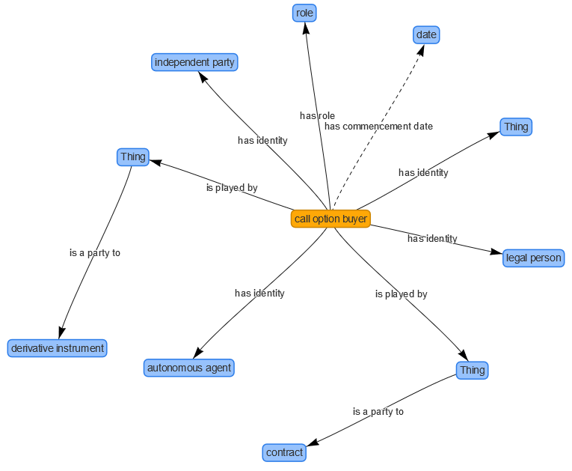
Knowledge Graphs for Financial Reporting
Financial Reporting Requirements
Standardize the reports using FIBO

Slide 26
Knowledge Graphs for Financial Reporting
Financial Reporting Requirements
Standardize the reports using FIBO
FIBO has many other use cases
Counter party exposure
Index analysis for ETF Development
Exchange instrument data offering

Slide 27
Summary
Knowledge Graphs in Finance
Financial Analytics
Financial Calculations
Financial Reporting

